Slide 1


VMware Hackathon Presentation

Slide 2
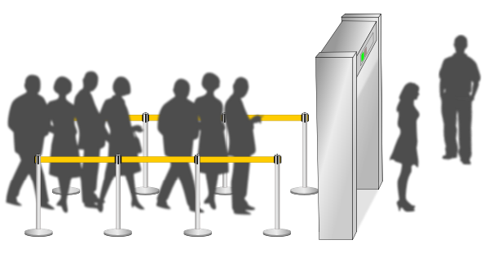
Problem Statement : Detect Tailgating and Alert Security Staff
Team Name : CRAZY_GEEKS
Team Leader :- AYUSH RAJ
Other Team Members :- 1. ASHWANI KUMAR
2. DIPIKA AGRAWAL
3. MEGHNA BARNWAL

Slide 3
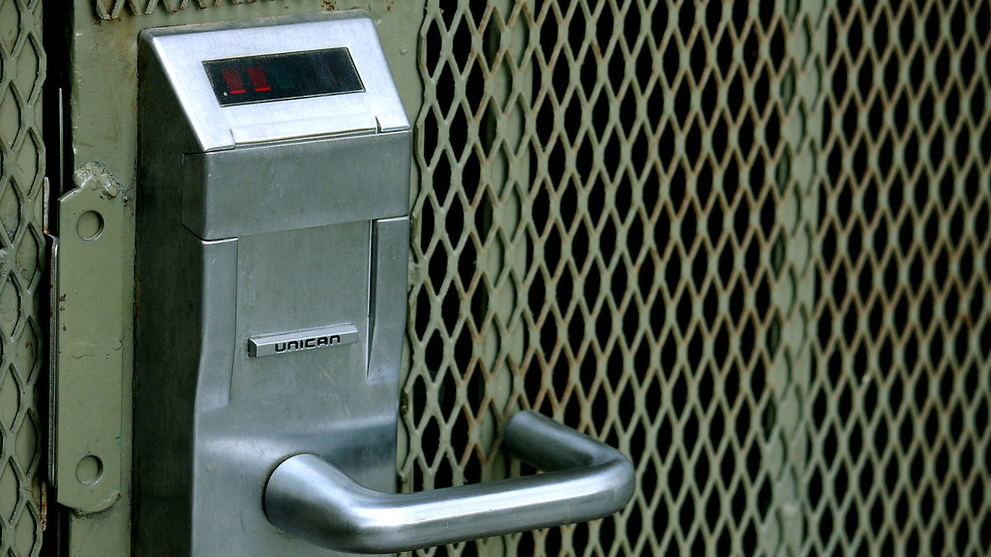
OUR ABSTRACT IDEA
Authentication using swipe card (there will be unique employee id, along with authorization result i.e. access denied or allowed for each employee).
We will keep track of how many persons cross a door through CCTV video clips given as the input.
If number of persons passing through an entrance is greater than the number of people authorized to enter, we will trigger a tailgating alarm.
Badge data of each person will be compared with human detection and alarm will send alert when a mismatch occurs.
This Photo by Unknown author is licensed under CC BY-SA-NC.

Slide 4
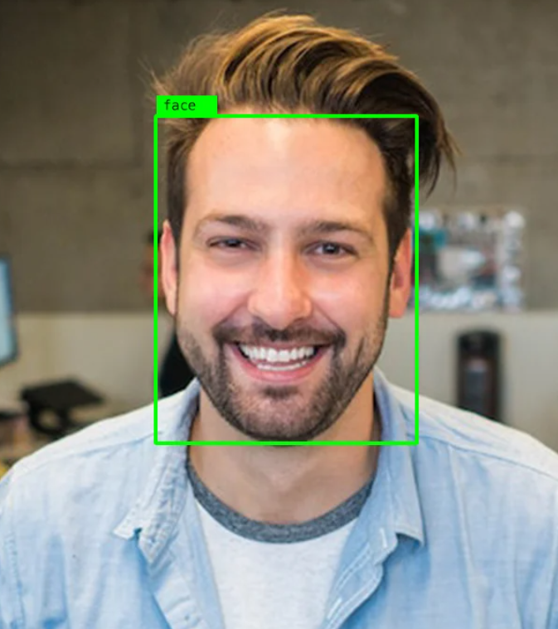

Techstack Used
OpenCV
Machine Learning
Deep Learning
NumPy
Dlib
imutils

Slide 5
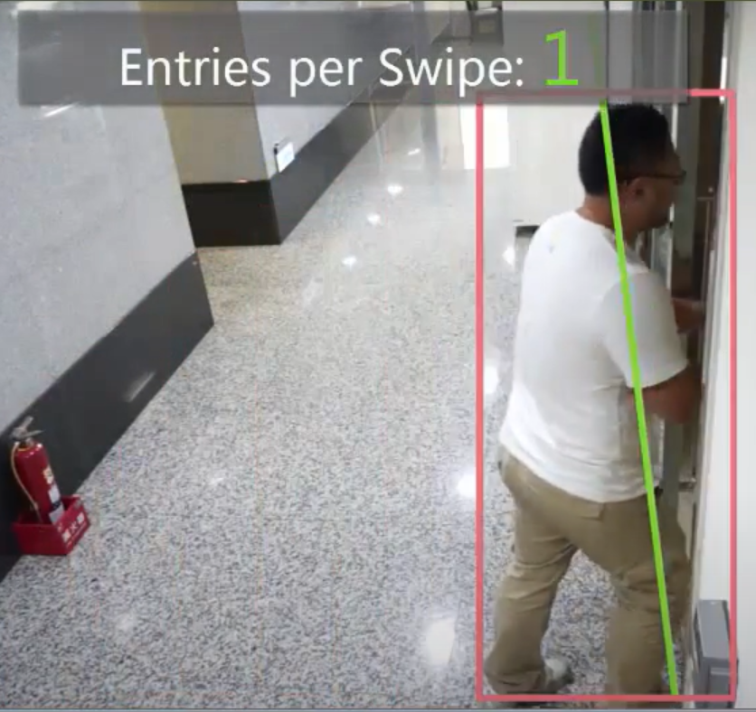
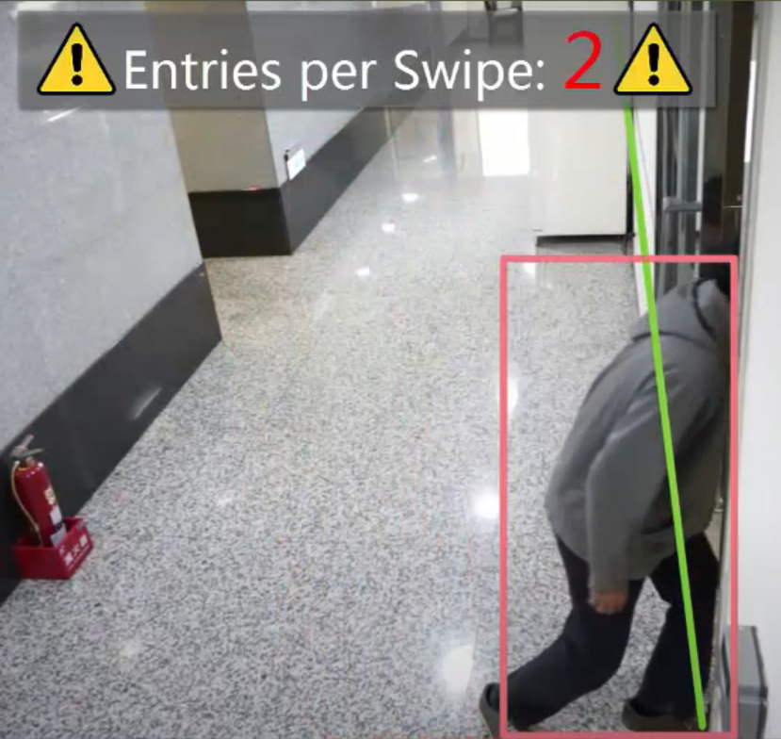
The Problem
Tailgating is such a common security breach that it’s among the top 3 security concerns of Fortune 1000 companies.
Tailgating can be through different ways:- an employee may open a door and hold it open for others or some unauthorized person may enter a door just after some authorized person (the authorized person being unaware of the act).

Slide 6
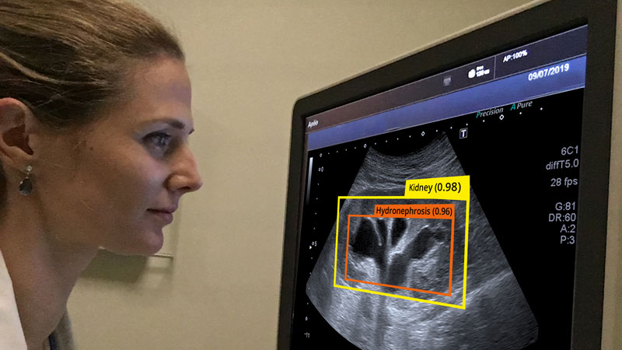
Solution
We will use computer vision to detect human entrances and exits . We integrate our data with access control systems in real-time. Data is compared with human detection to trigger an alert when a mismatch occurs.
Raspberry pi will be used as a main controller along with camera which enables to access image processing with any portable embedded system.
Some Deep Learning algorithm will be used to detect the human body . It analyses the image features by using square by functions. When we are not in the “detecting” phase we are in the “tracking” phase. For each of our detected persons, we create an object tracker to track the object as it moves around the frame. Our object tracker should be faster and more efficient than the object detector. We’ll continue tracking until we’ve reached the N-th frame and then re-run our object detector. The entire process then repeats.
This Photo by Unknown author is licensed under CC BY.

Slide 7
Integration with security monitoring and control systems provides notification when a tailgating or reverse entry event has occurred.
For people counting and reporting: camera installation will be in both ways i.e. angular and overhead. Angular will be for applications like city surveillance to cover wider area and overhead installation for entry and exit points.
We will use video analytics for surveillance system operator, this will meet the needs of security officers and corporate managers they seek to make practical and effective use of their surveillance system.
We will have an option to send alarms to VMS or alarm center in case any discrepancy is found.

Slide 8
Thank You!

